Slide 1
Data Visualization
Lecture 20
Unit -5

Slide 2
Goal of data visualization
A successful visualization is one that efficiently and accurately conveys the desired information to the targeted audience, while bearing in mind the task or purpose of the visualization (exploration, confirmation, presentation)
A visualization may be ineffective for a number of reasons. It might be too confusing or complex to be interpreted by the intended audience, or some of the data may have been distorted, occluded or lost during the mapping process. Other signs of deficient visualizations are the lack of support for view modification or color map control. Even aesthetics can influence the success of a visualization; a visually unappealing presentation can affect an audience’s willingness to look at the images.

Slide 3
STEPS IN DESIGING DATA VISUALIZATION
Creating a visualization involves deciding how to map the data fields to graphical attributes, selecting and implementing methods for modifying views, and choosing how much data to visualize.
Additional information regarding the data being shown (e.g., labels) and the mapping (e.g., a color key) are also essential to facilitate interpretation, and must be integrated into the visualization

Slide 4
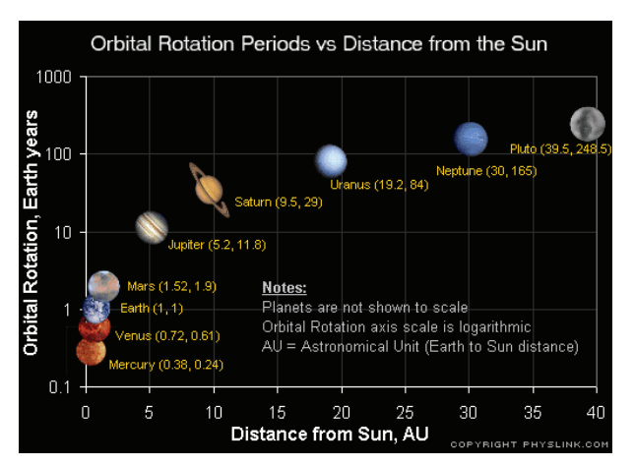
Intuitive Mappings from Data to Visualization
To create the most effective visualization for a particular application, it is critical to consider the semantics of the data and the context of the typical user. By selecting data-to-graphics mappings that cater to the user’s domain-specific model, the interpretation of the resulting image will be greatly facilitated.
Mapping spatial data attributes, such as longitude and latitude, to screen position is perhaps the most common and intuitive mapping found in visualizations.
Using intuitive scatterplot symbols to show the distance from planets to the sun versus the duration of a single orbit

Slide 5
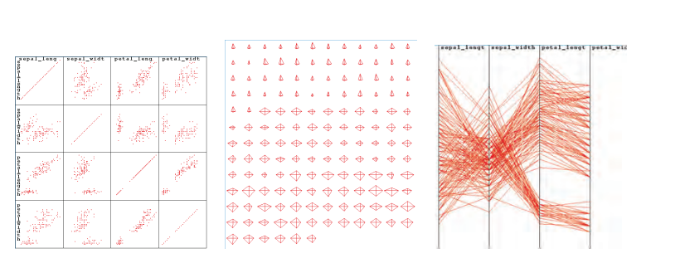
Selecting and Modifying Views
Except for fairly simple data sets, one view is rarely sufficient to convey all the information contained in the data. The key to developing an effective visualization is to be able to anticipate the types of views and view modifications that will be of most use to the typical user, and then provide intuitive controls for setting and customizing the views.
Scrolling and zooming operations are needed if the entire data set cannot be presented at the resolution desired by the user.

Slide 6
Information Density—When Is It Too Much or Too Little?
One of the key decisions one makes when designing a visualization is determining how much information to display. This gives rise to two extremes. The first, which might be called “gratuitous graphics,” occurs when there is very little information to present.
The other extreme, trying to convey too much information, is also a common problem. Excessive information content can lead to confusion, intimidation, and difficulties in interpretation on the part of the viewer.
Another common cause of cluttered displays is large or unevenly distributed data sets.
here are many effective solutions to the problem of excessive information content in a visualization. One method is to give the user the option of disabling or enabling different components of the display

Slide 7
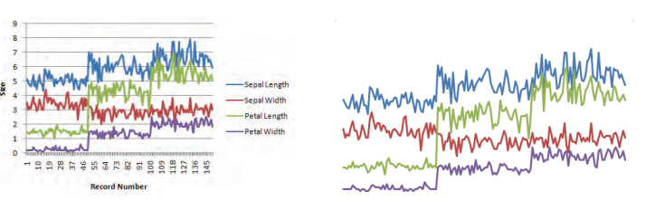
Keys, Labels, and Legends
A common problem with many visualizations is that insufficient information is provided to the user to allow unambiguous and accurate interpretation. This supporting information should begin with a detailed caption indicating the particular data fields being displayed, and the mappings that were used.

Slide 8
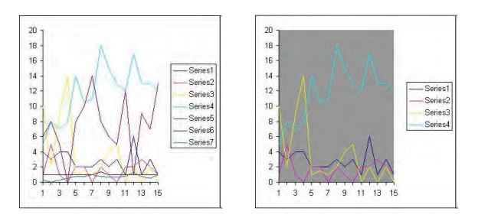
Using Color with Care
One of the most frequently misused parameters in visualization design is that of color. Selecting the wrong color map or attempting to convey too much quantitative information through color can lead to ineffective or misleading visualizations. Also, since color perception is context-dependent

Slide 9
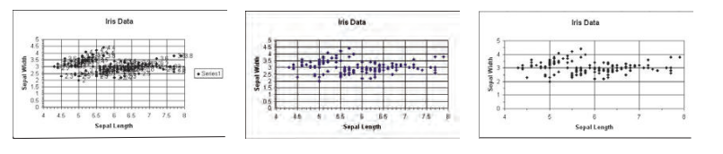
The Importance of Aesthetics
Once we have ensured that our designed visualization conveys the desired information to the user (function), the final step is to assess the aesthetics (form) of the results. The best visualizations are both informative and pleasing to the eye.
In contrast, a visualization might be so visually unappealing that it detracts from the communication process.
An aesthetically pleasing visualization invites the viewer to study it in depth. There are many guidelines for attractive visualization design that can be drawn from the art and graphic design communities. These include focus, Balance, Simpilicity.

